Slide 1
Lecture 3
STAT 451 VISUALIZING DATA
Fall 2024
Many thanks to Prof. Abel Rodriguez, many slides from this course are adapted from his data visualization class.

Slide 2
The visualization wheel
More complex and deeper
Density
Multidimensionality
Functionality
Originality
Abstraction
Novelty
Redundancy
Figuration
Familiarity
Decoration
Unidimensionality
Lightness
More intelligible and shallower
Graph from Alberto Cairo, The functional art, Figure 3.2.

Slide 3
The visualization wheel
The outer layer is divided into two hemispheres, each with six features:
Upper hemisphere corresponds to deep and complex graphs (more effort, but also reward).
Lower hemisphere corresponds to easier to understand but also shallower graphs.
The different variables are somewhat dependent.
Highly subjective: this is for personal use!
When you draft a visualization, rank it in every axis.

Slide 4
Multidimensional/Unidimensional
Measures two slightly different things:
How many layers (types of data) are represented simultaneously in a single visualization.
In how many ways each type data can be explored.

Slide 5
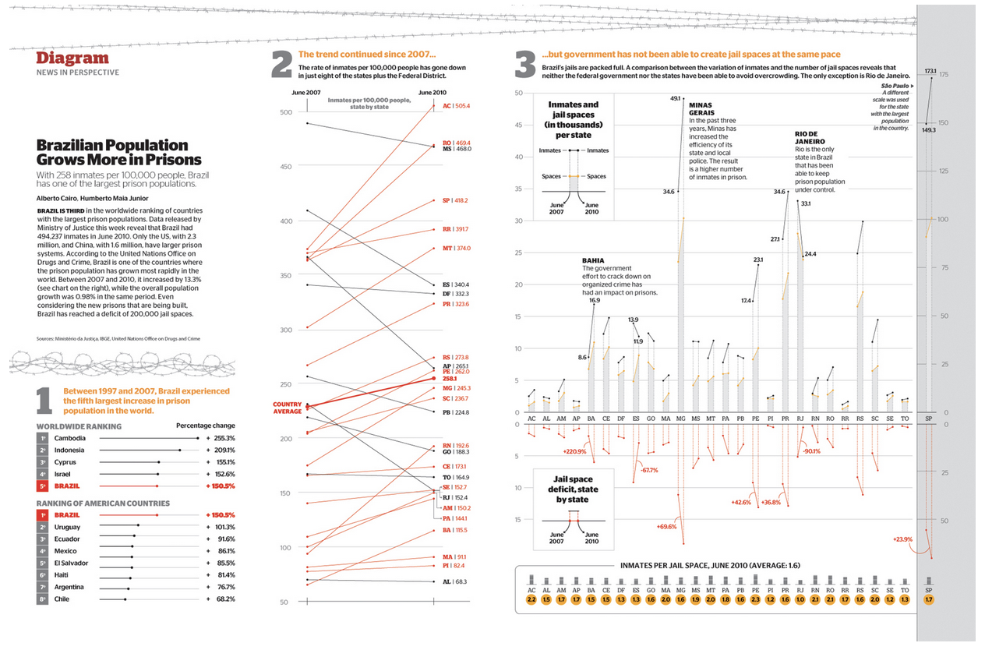
Multidimensional/Unidimensional
Graph from Alberto Cairo, The functional art, Figure 3.1.

Slide 6
Multidimensional/Unidimensional
Multidimensional:
Readers can dig deeply into the data.
The same data can be seen in different ways.
Critics:
Too complex, abstract, dense.
Far from the aesthetics expected by the readers.

Slide 7
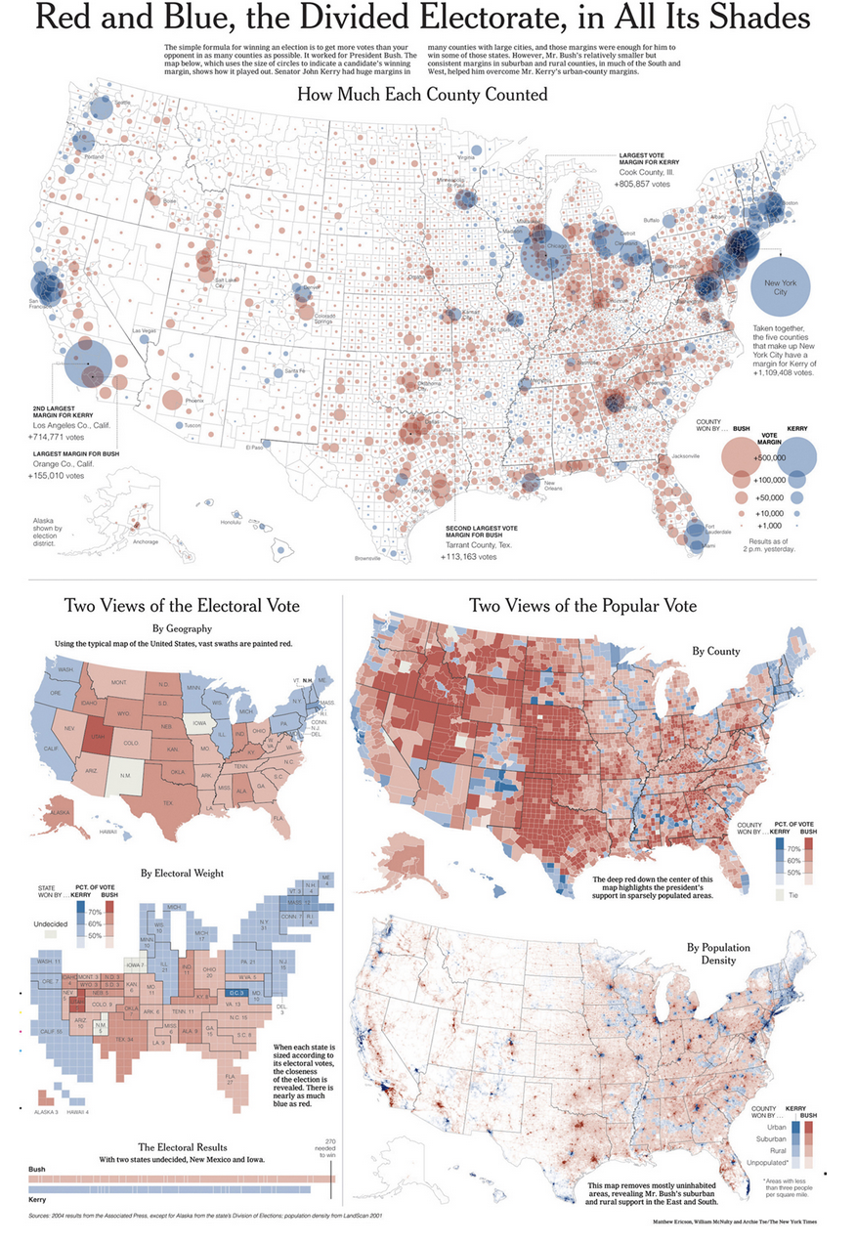
Multidimensional/Unidimensional
Graph from Alberto Cairo, The functional art, Figure 3.5.

Slide 8
Multidimensional/Unidimensional
Multidimensional:
Popular vote represented by:
county,
population density.
Vote by state represented by:
a choropleth map,
a cartogram.

Slide 9
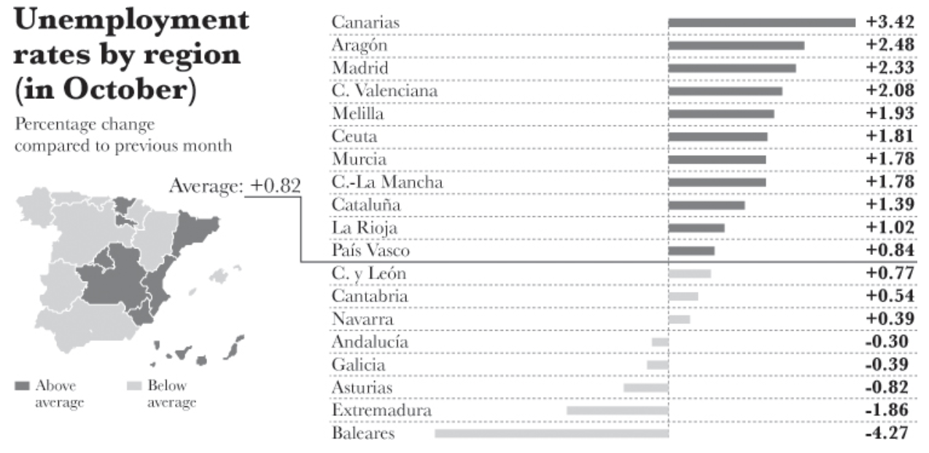
Multidimensional/Unidimensional
Graph from Alberto Cairo, The functional art, Figure 2.7.

Slide 10
Multidimensional/Unidimensional
Multidimensional, in the sense that it lets you explore the data in different ways:
Accurately compare unemployment levels in different regions of Spain.
Understand spatial patterns of unemployment.

Slide 11
Density/Lightness
Amount of information it displays vs. the amount of ink/space it uses.

Slide 12
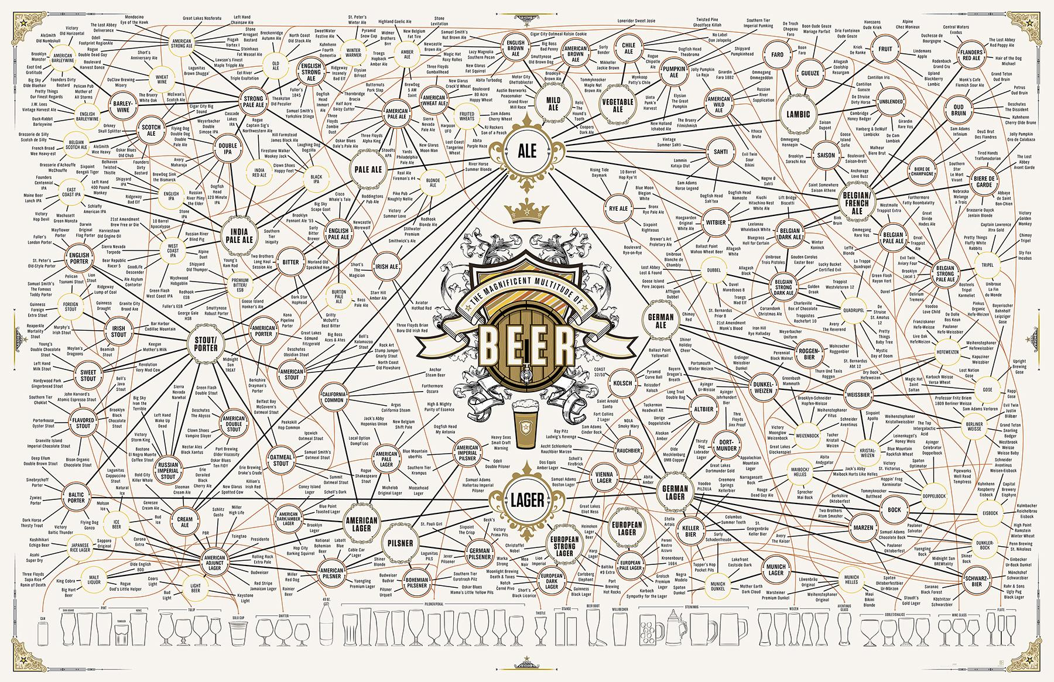
An extremely dense infographic

Slide 13
Functionality/Decoration
How many element not directly used to enhance comprehension are being included in the visualization?
Related to density/lightness: More decoration typically makes the graph denser too, but not necessarily.
Decoration can interfere with the information in a chart if not handled well.

Slide 14
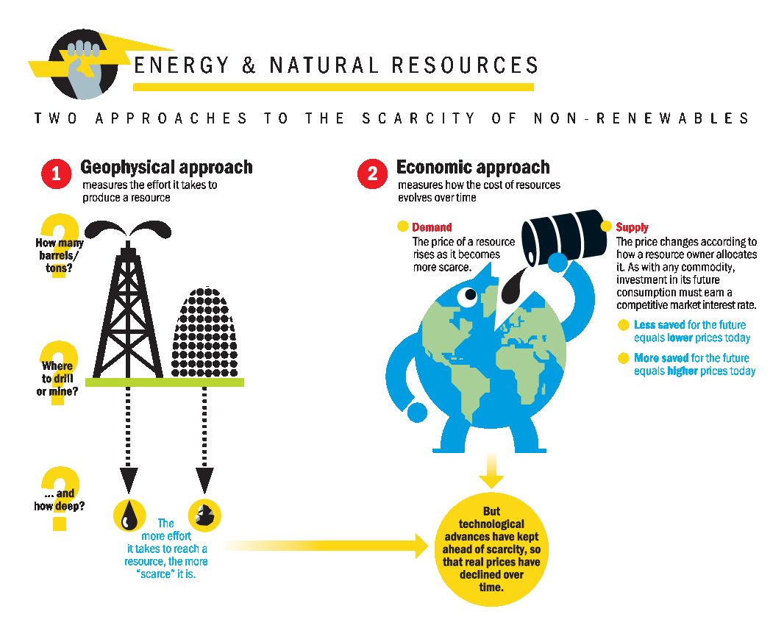
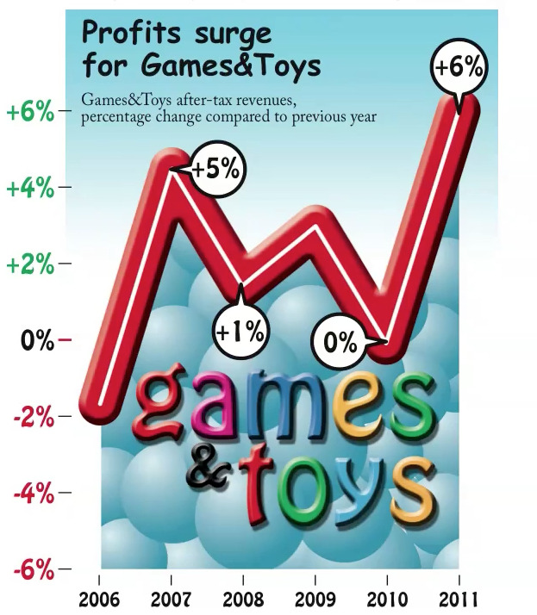
Highly decorative graphs
Relatively light!
Relatively dense!
Nigel Holmes for the Bertelsmann Foundation

Slide 15
Density/Lightness and Functionality/Decoration
Minimalists like Tufte and Few would argue that graphs need to both light and functional.
Art designers such as Holmes would argue that decoration is important and you can somewhat sacrifice lightness … as long as you don’t overdo it.

Slide 16
Originality/Familiarity
Some graphic forms have become very common, and pretty much every audience will be familiar with them:
Bar charts, lines charts, pie charts, scatter plots, …
Other graphics are known only to specialists
Box plots, ternary plots, stream graphs, ….
You might want to invent your own type of visualization!
http://www.perceptualedge.com/articles/visual_business_intelligence/building_insight_with_bricks.pdf

Slide 17
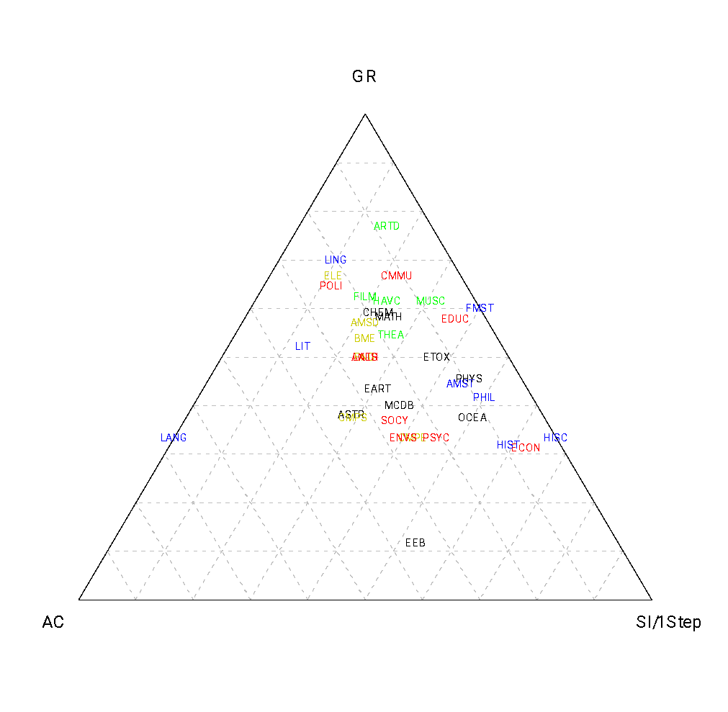
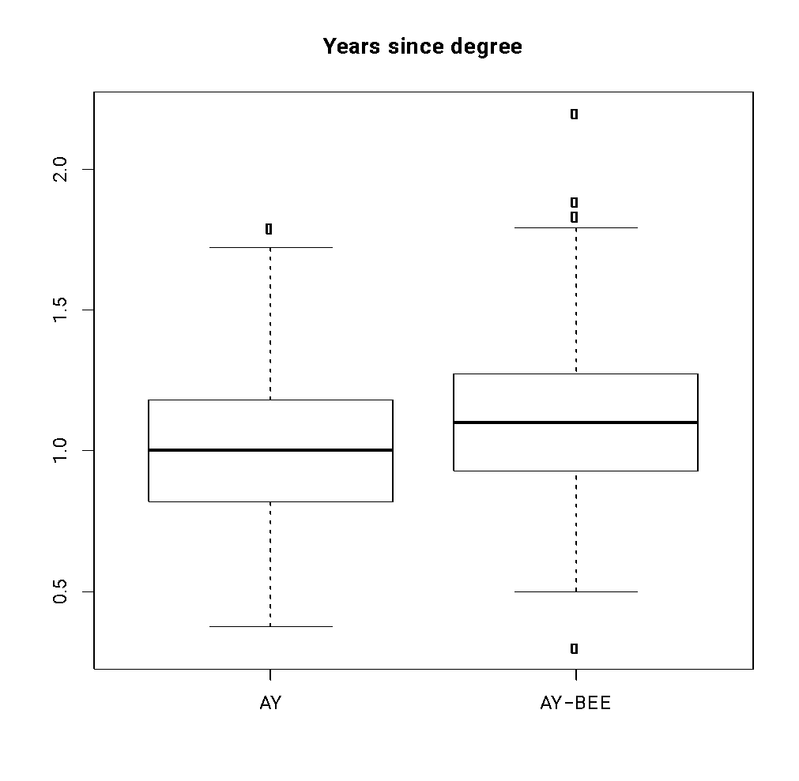
Examples of somewhat uncommon graphs
Ternary plot
Boxplot

Slide 18
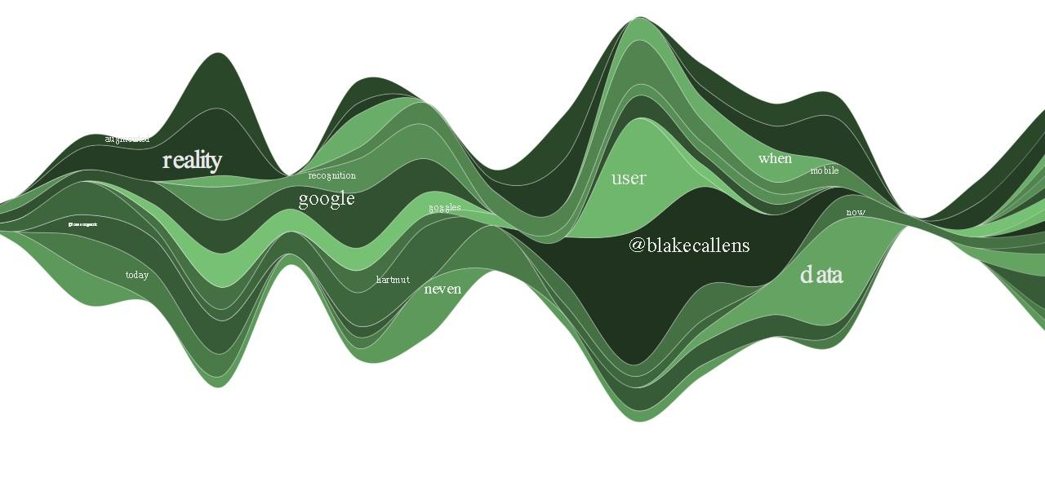
Examples of somewhat uncommon graphs
Stream plot

Slide 19
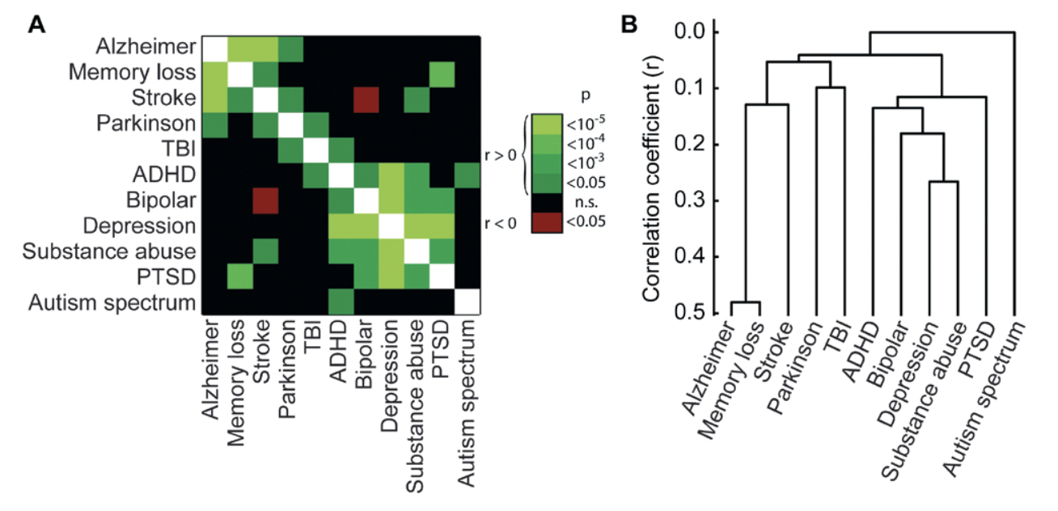
Originality/Familiarity
https://journals.plos.org/plosone/article/figure?id=10.1371/journal.pone.0030405.g001
Graph from Alberto Cairo, The functional art, Figure 3.10.

Slide 20
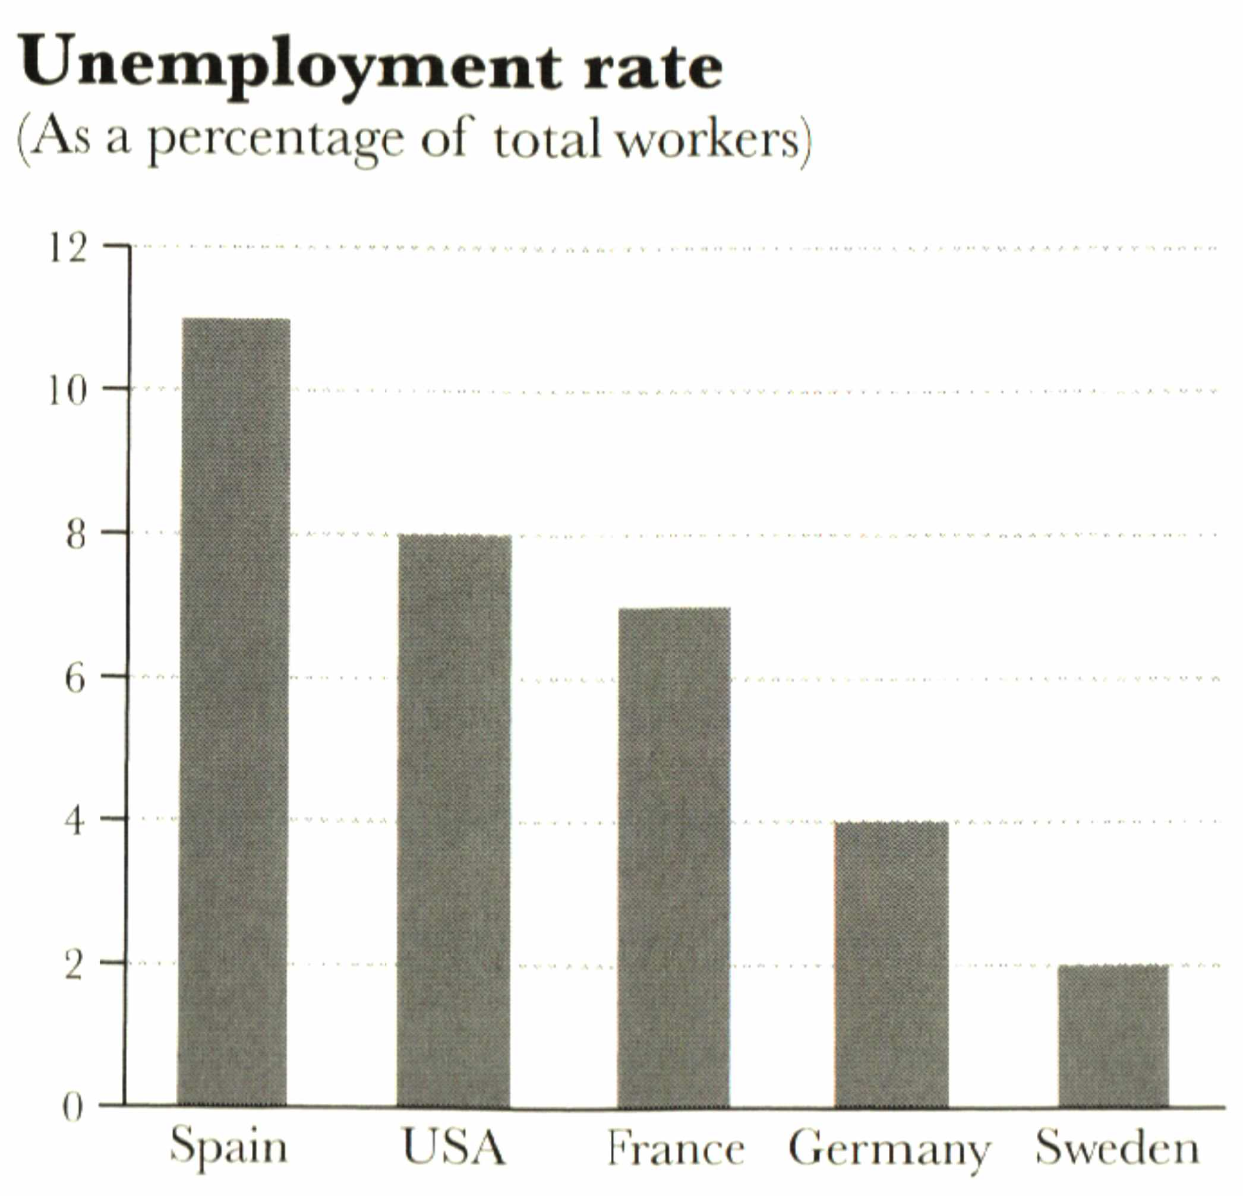
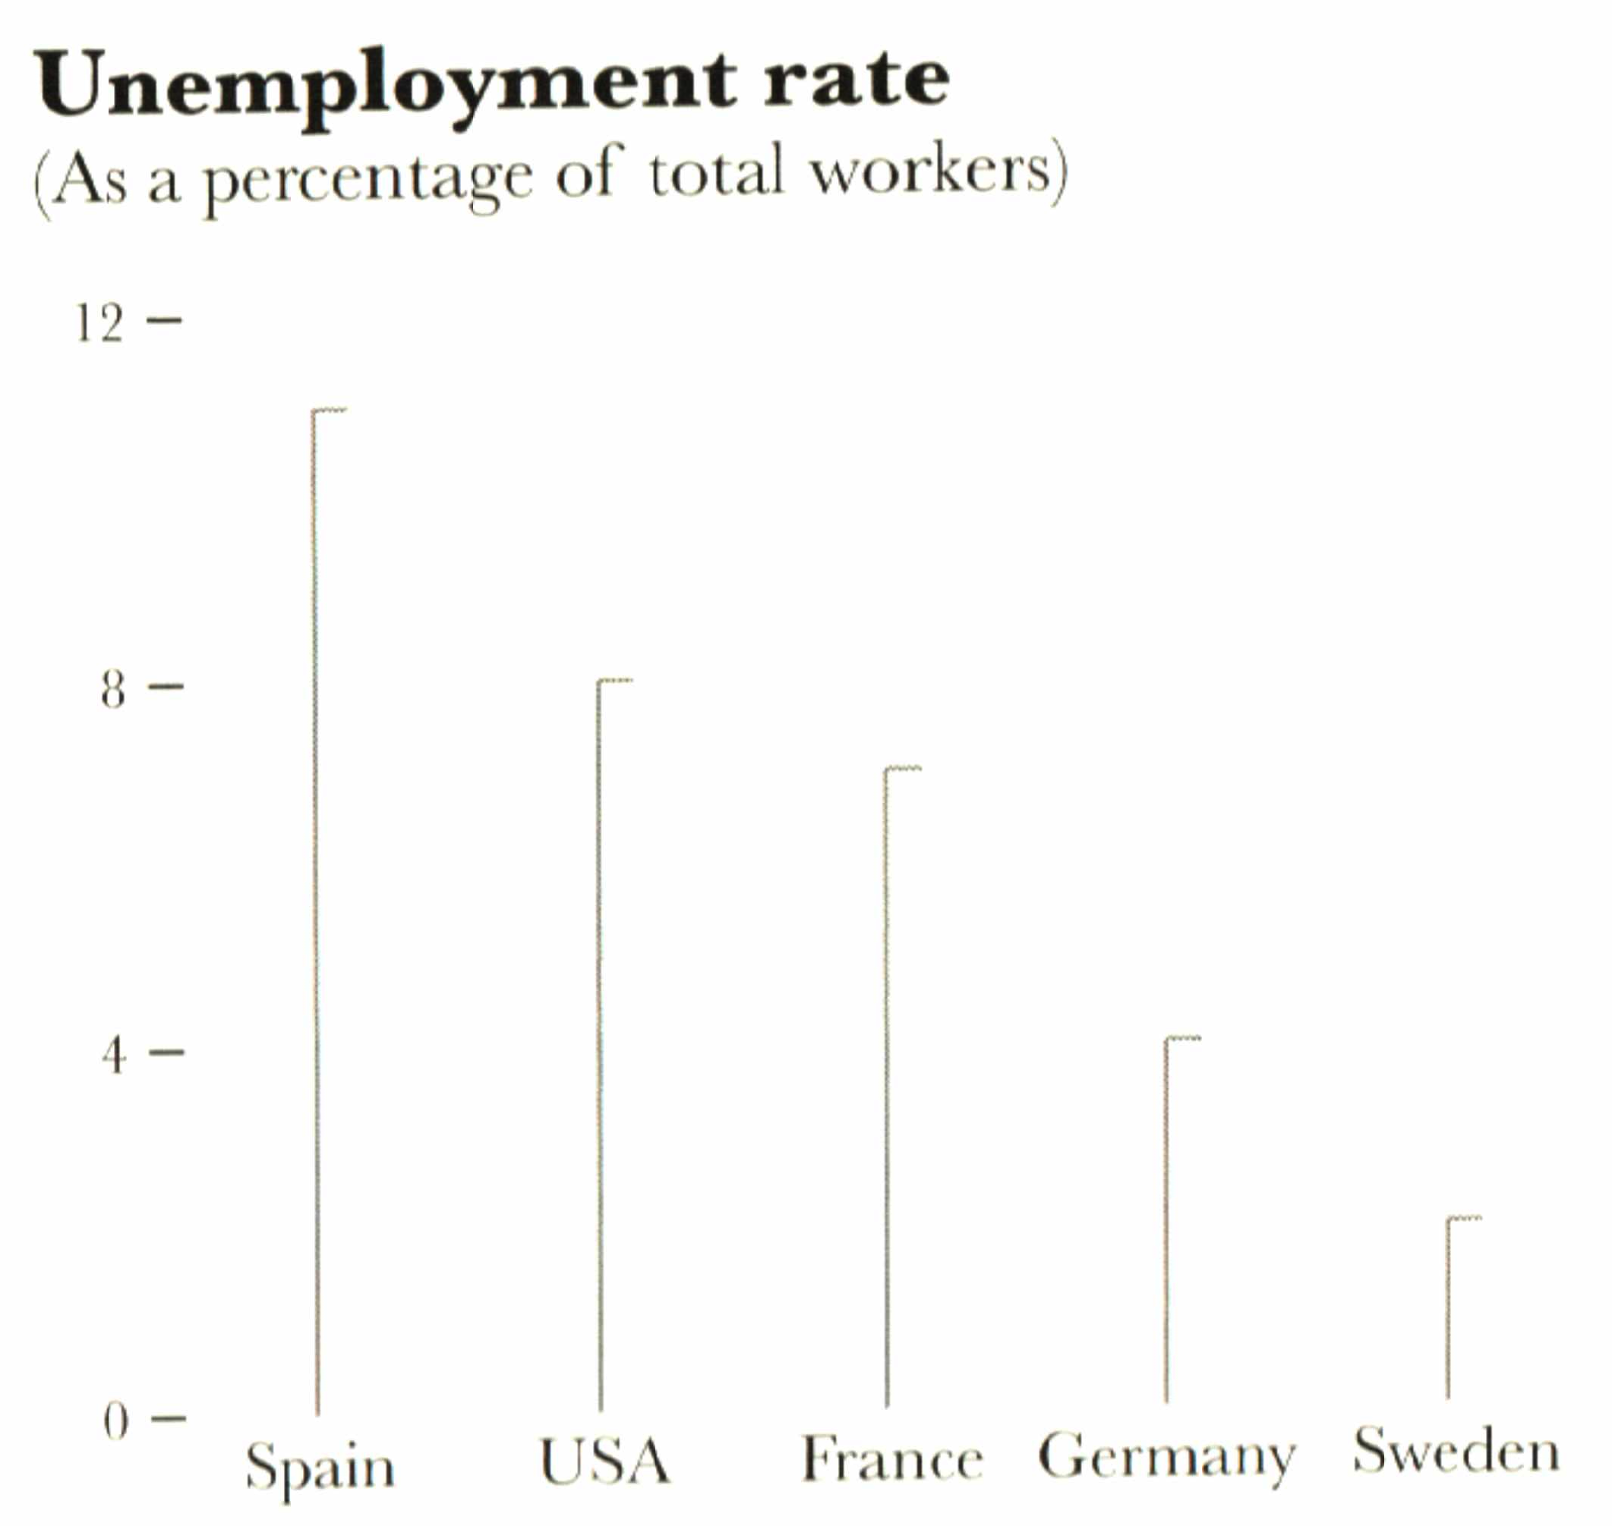
Remember our discussion about maximizing data/ink ratio …

Slide 21
Novelty/Redundancy
Do you explain many things once or do you explain the same thing in multiple different ways.
In a single visualization, you might want to encode the same information using multiple visual cues.
In an infographic, you might want to use different displays to show the same data in different ways.
Redundancy in an infographic can be useful if the claim is controversial!

Slide 22
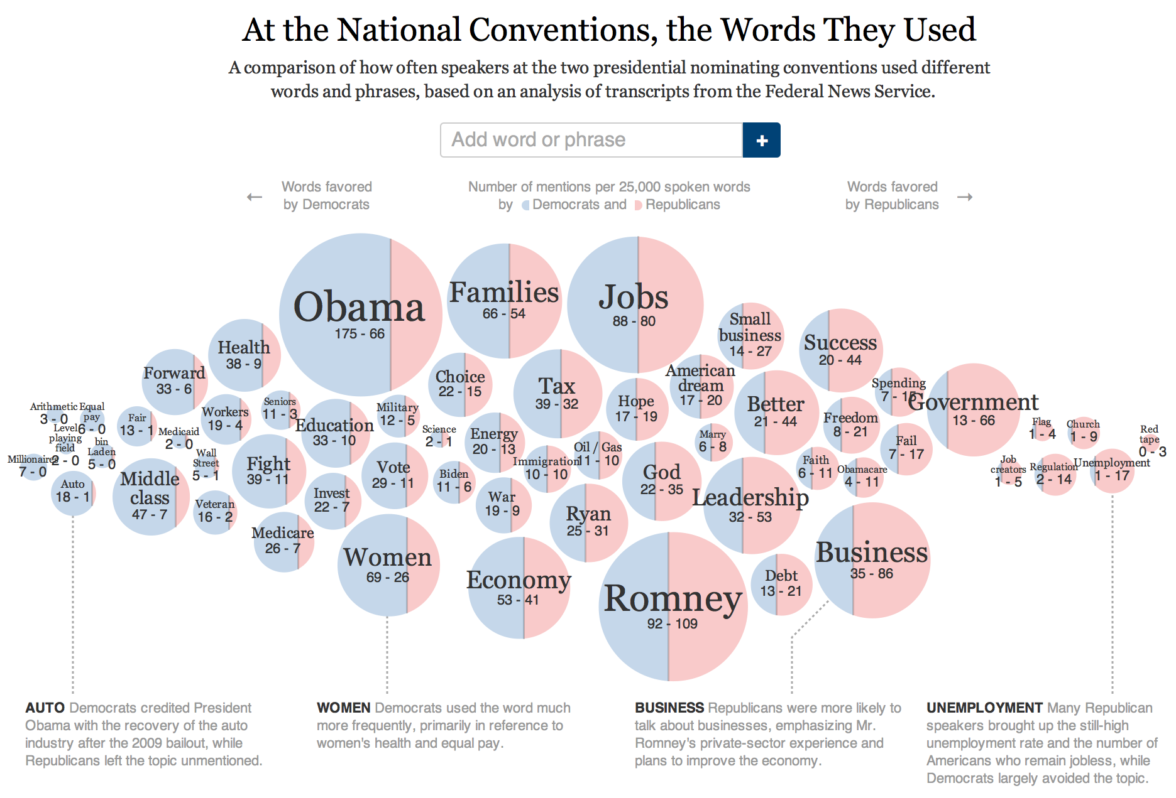
Redundancy in visualization
The relative usage of the word by each party is encoded by both the color in each circle
and by the position of the circle in the x axis.
http://www.nytimes.com/interactive/2012/09/06/us/politics/convention-word-counts.html?_r=0

Slide 23
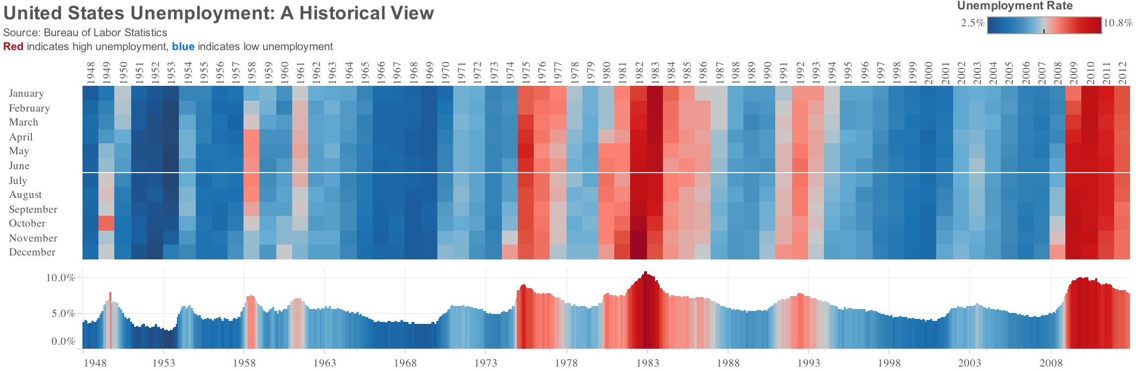
Redundancy in visualization
Top graph makes it easier to spot seasonal patterns (although none seems to be present)
http://vizwiz.blogspot.com/2013/02/improving-wsj-historical-us.html

Slide 24
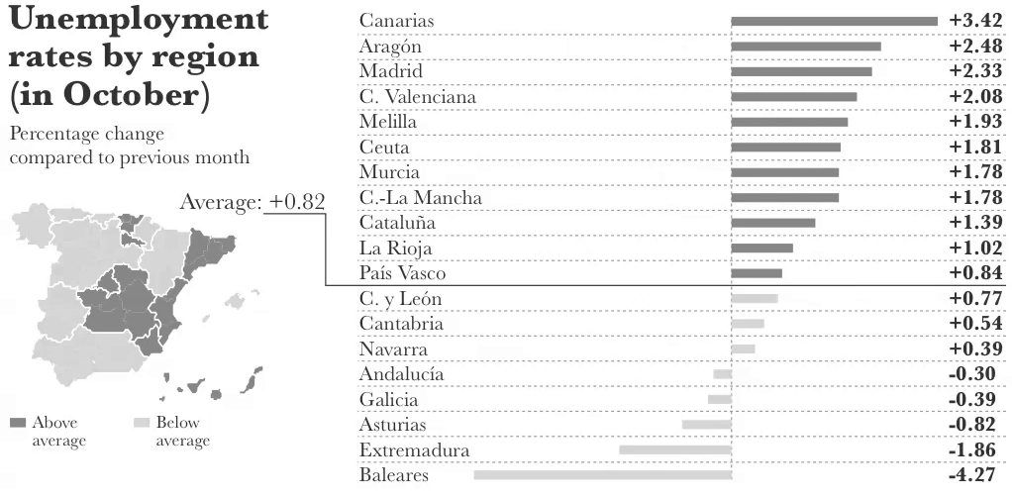
Redundancy in visualization
Accurate comparisons using the bar plot (position). Color used as a visual cue to point out regions above/below average
General geographic sense from the map (color is fine here because we do not want to use the map for detailed comparisons).
From “The Functional Art”, page 38.

Slide 25
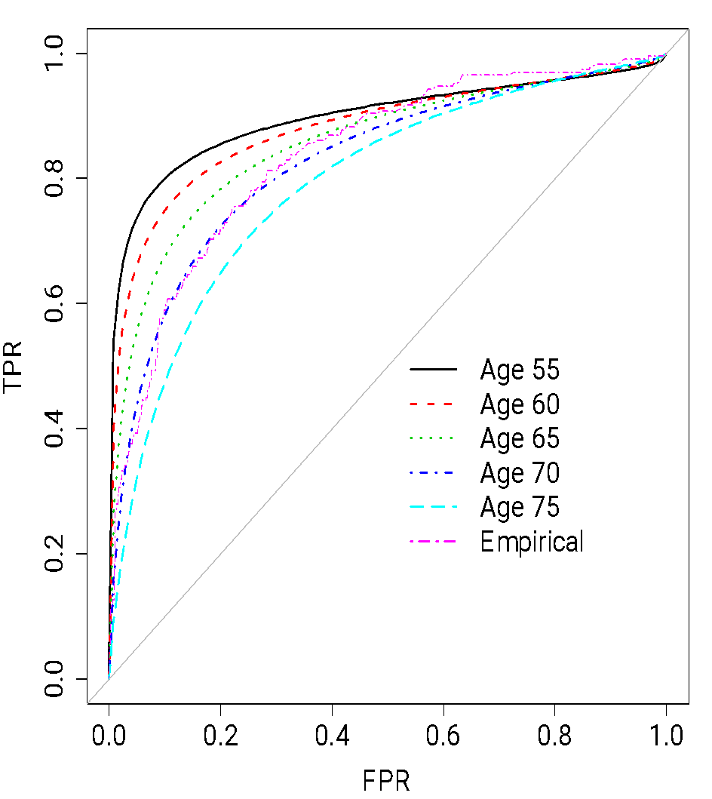
Redundancy in visualization
Note that we use both color and line type to differentiate the lines corresponding to different ages.

Slide 26
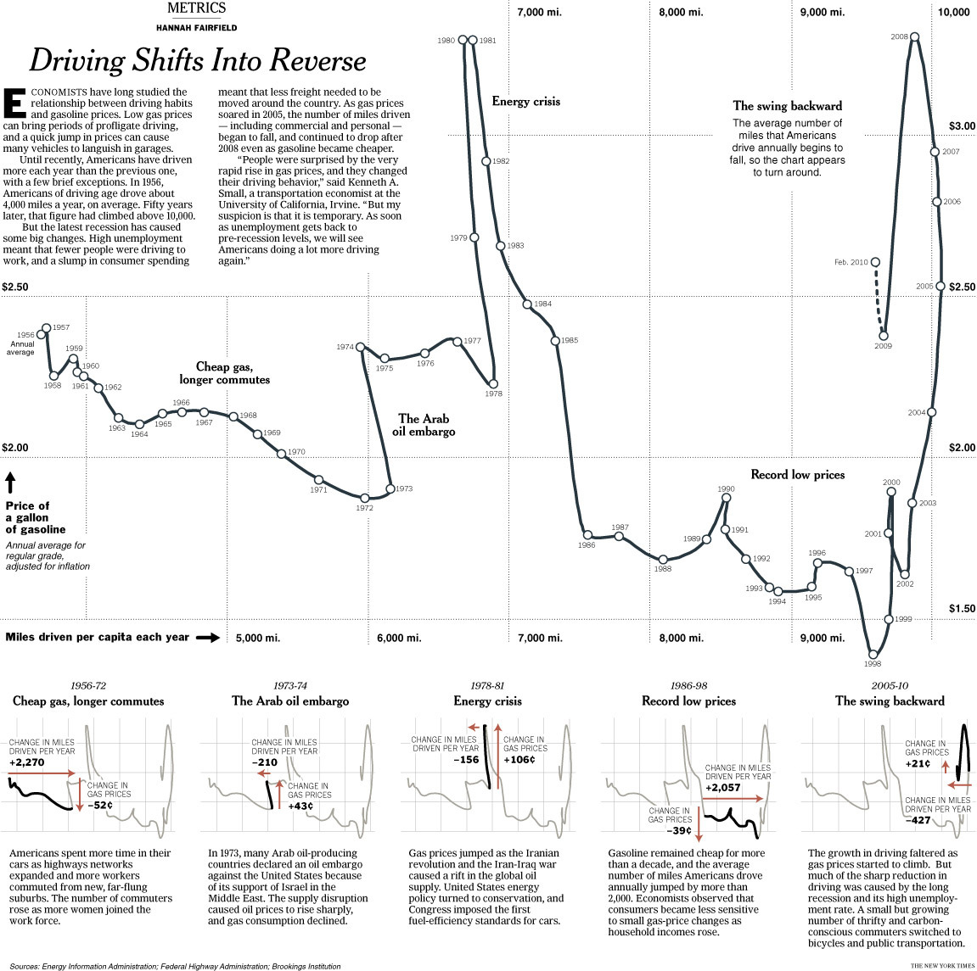
Redundancy in an infographic!
Graph from Alberto Cairo, The functional art, Figure 8.8.

Slide 27
Redundancy
Same map, different data (5 maps).
Same data, different representation (choropleth and cartogram).
Graph from Alberto Cairo, The functional art, Figure 3.5.

Slide 28
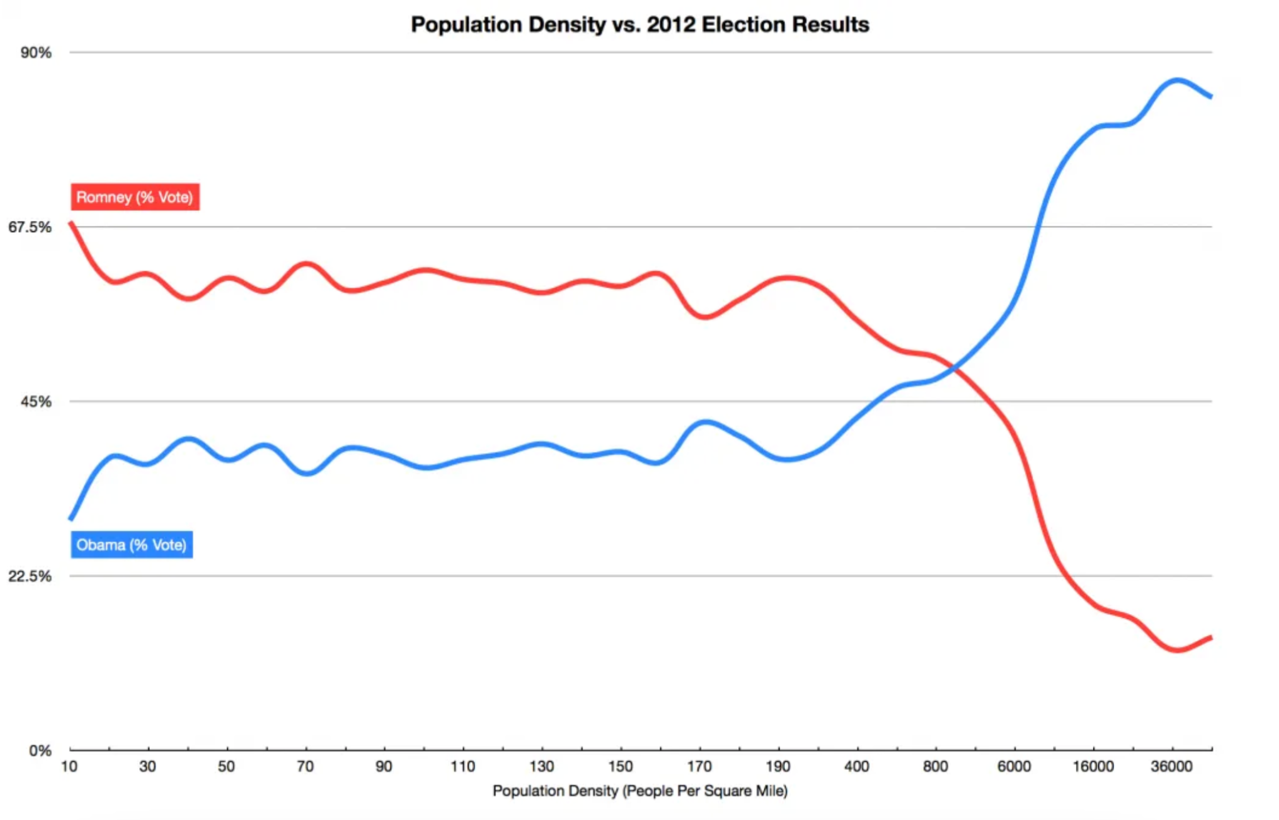
Do we need a map?
https://davetroy.medium.com/is-population-density-the-key-to-understanding-voting-behavior-191acc302a2b

Slide 29
Abstraction/Figuration
A graphic is completely figurative when the relationship between the referent (the real object) and the representation is perfectly mimetic. The further the representation is from the real object, the more abstract it is.
A photograph of a person is more figurative (less abstract) than a pictorial symbol of the person!

Slide 30


Abstraction/Figuration
More figurative …
More abstract …

Slide 31
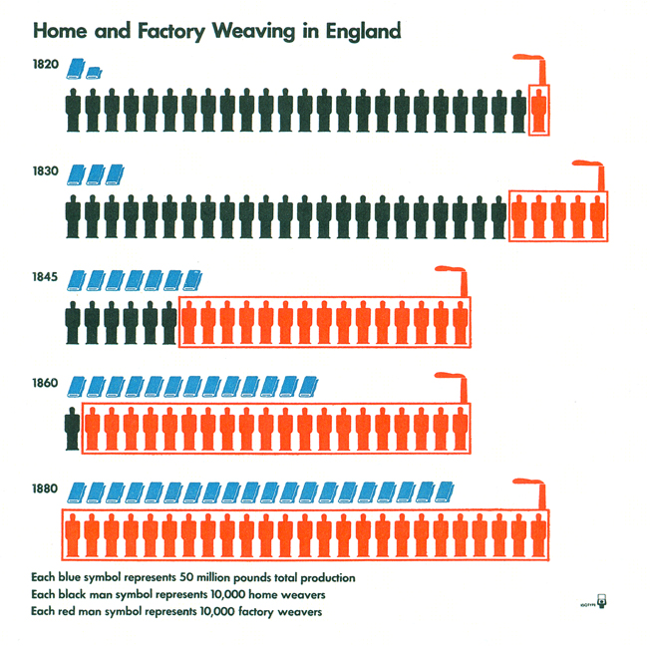
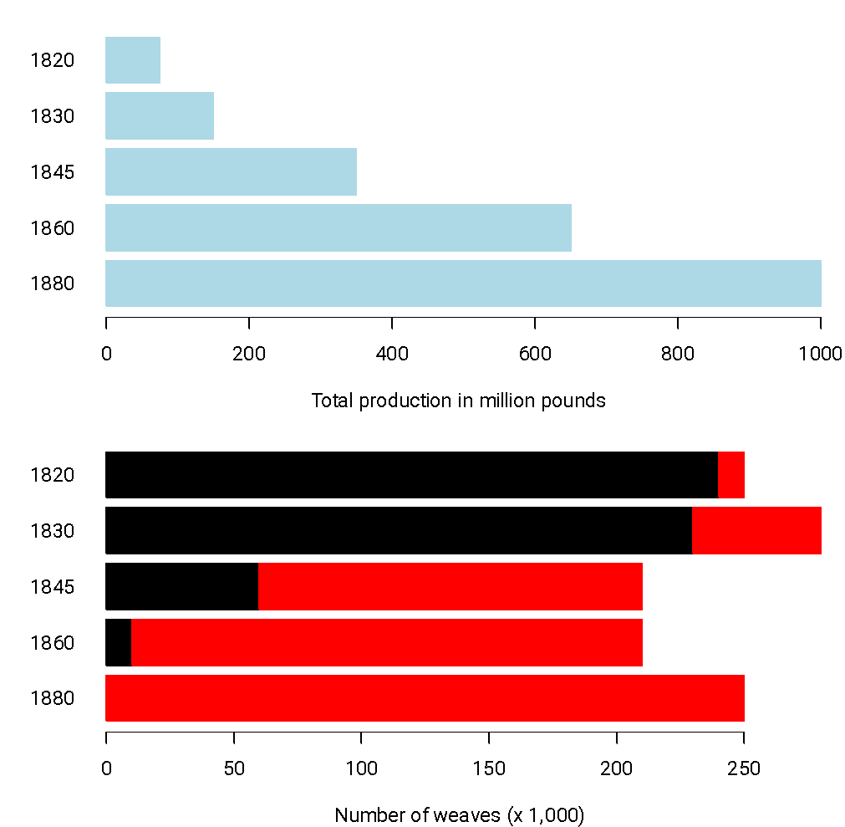
Abstraction/Figuration
More figurative
More abstract
Otto & Marie Neurath Isotype Collection, University of Reading

Slide 32
Abstraction/Figuration
Be careful to differentiate between abstract/figuration and functional/decorative:
If you create another unit chart for the “Home and Factory Weaving in England” that uses circles (rather than people) to represent the units, you still have a graph that is quite decorative, but that is also pretty abstract.

Slide 33
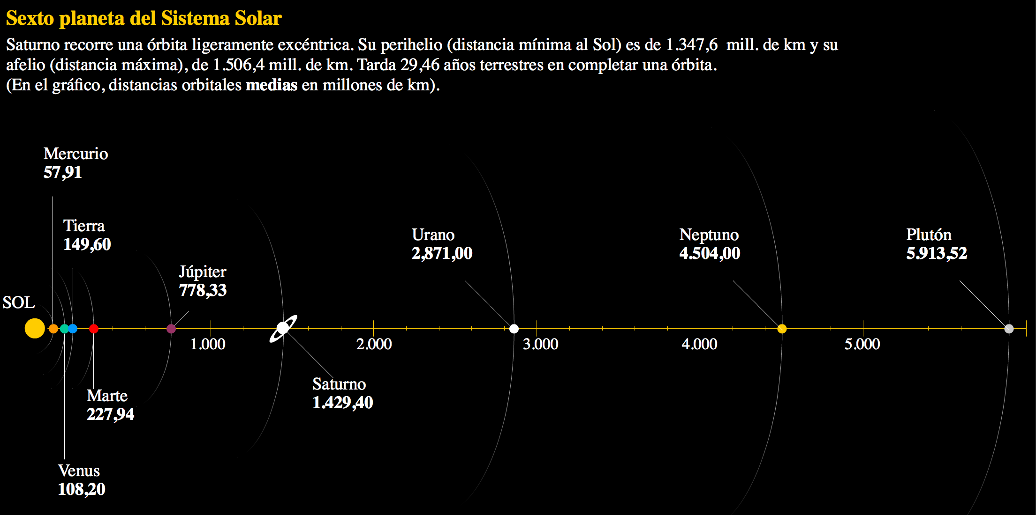
A relatively abstract graph
Graph from Alberto Cairo, The functional art, Figure 3.3.

Slide 34
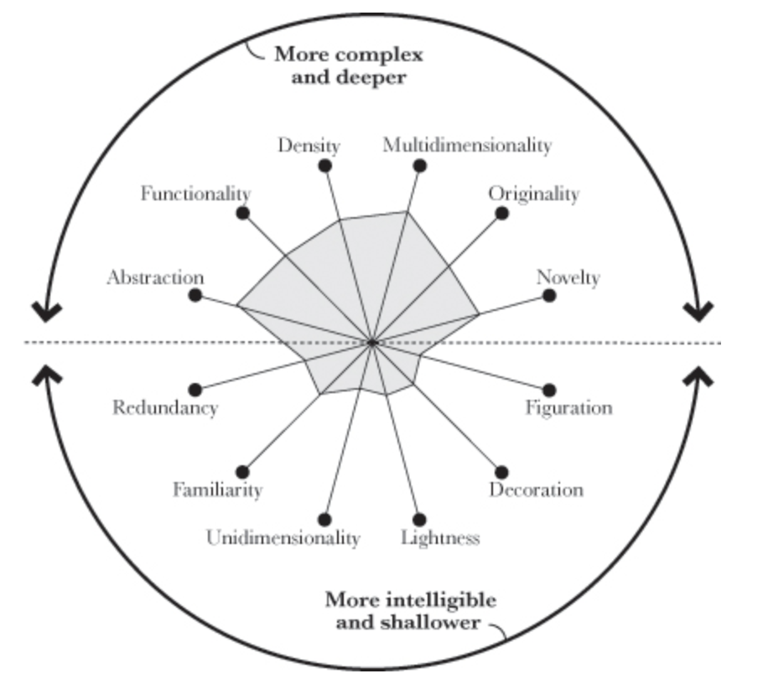
Visualization wheel of the prison graphics

Slide 35
To summarize
Function over form!
Minimalistic!
Know and care about your reader!
Anticipate your reader needs and desires!

Slide 36
More examples of visualizations
http://www.nytimes.com/interactive/2012/12/30/multimedia/2012-the-year-in-graphics.html
http://www.nytimes.com/newsgraphics/2013/12/30/year-in-interactive-storytelling/
http://www.nytimes.com/upshot/

